Slide 1

Interpreting Human Development Index
Data Mining - Carnegie Mellon University
Group G- Dhruv Bhogle, Ankit Gupta, Payal Fofadiya, Prateek Bawkar, Sahil Nyati
Client- Dr. Artur Dubrawski on behalf of United Nations

Slide 2
Human Development Index
The Human Development Index (HDI) is a statistical score which is used to rank countries into four tiers of human development.
VERY HIGH, HIGH, MEDIUM, LOW

Slide 3



Factors used to calculate Human Development Index (HDI)
Long and health life
Quality of education
Standard of Living
Mortality
Life Expectancy
Primary
Secondary
Tertiary
GDP
Investments
Income

Slide 4
How is HDI calculated?
Features | Value
GDP | 4.5
Mortality of infants | 0.3
Secondary Education | 1.23
Median age | 23.55
Life Expectancy | 78.5
Mortality in females | 0.67
Tertiary Education | 0.7
Mortality in males | 0.8
Urban population | 0.85
…
…
…
HDI Index
5.6

Slide 5
How are HDI labels assigned?
Countries
..
USA
Norway
..
..
Mexico
Brazil
..
..
India
China
..
..
Kenya
Myanmar
..
VERY HIGH
HIGH
MEDIUM
LOW

Slide 6
Important Features identified by different models
Prediction Models | Decision Tree | Linear Regression using exhaustive feature selection | Random Forest
GDP | X | X | X
Secondary Edu | X | X | X
Mortality Under 5 | X | X | X
Median Age |  | X | X
Primary |  | X
Tertiary |  | X
Mortality | X
Life Expectancy |  |  | X
Mortality Adult Female |  |  | X

Slide 7
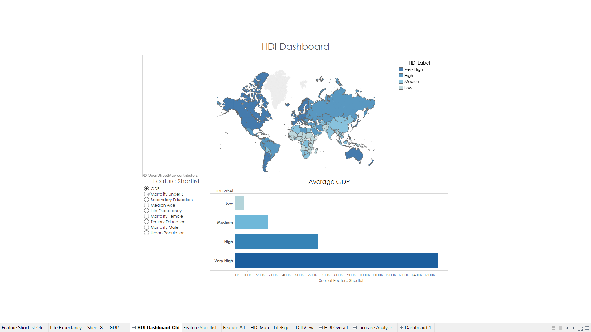

Slide 8
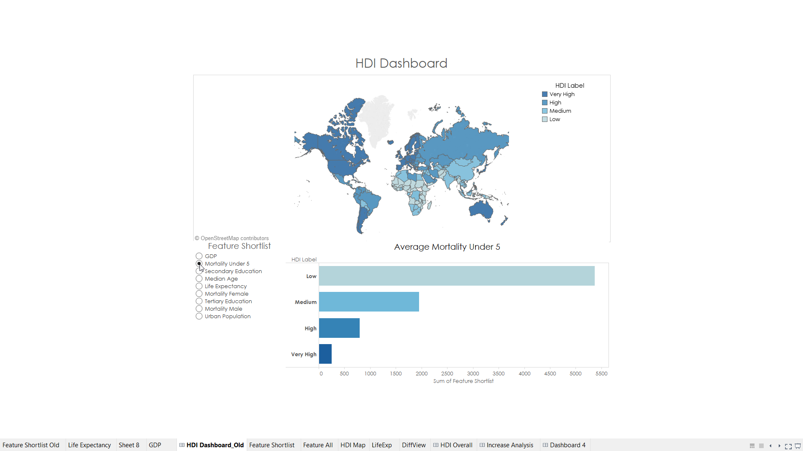

Slide 9
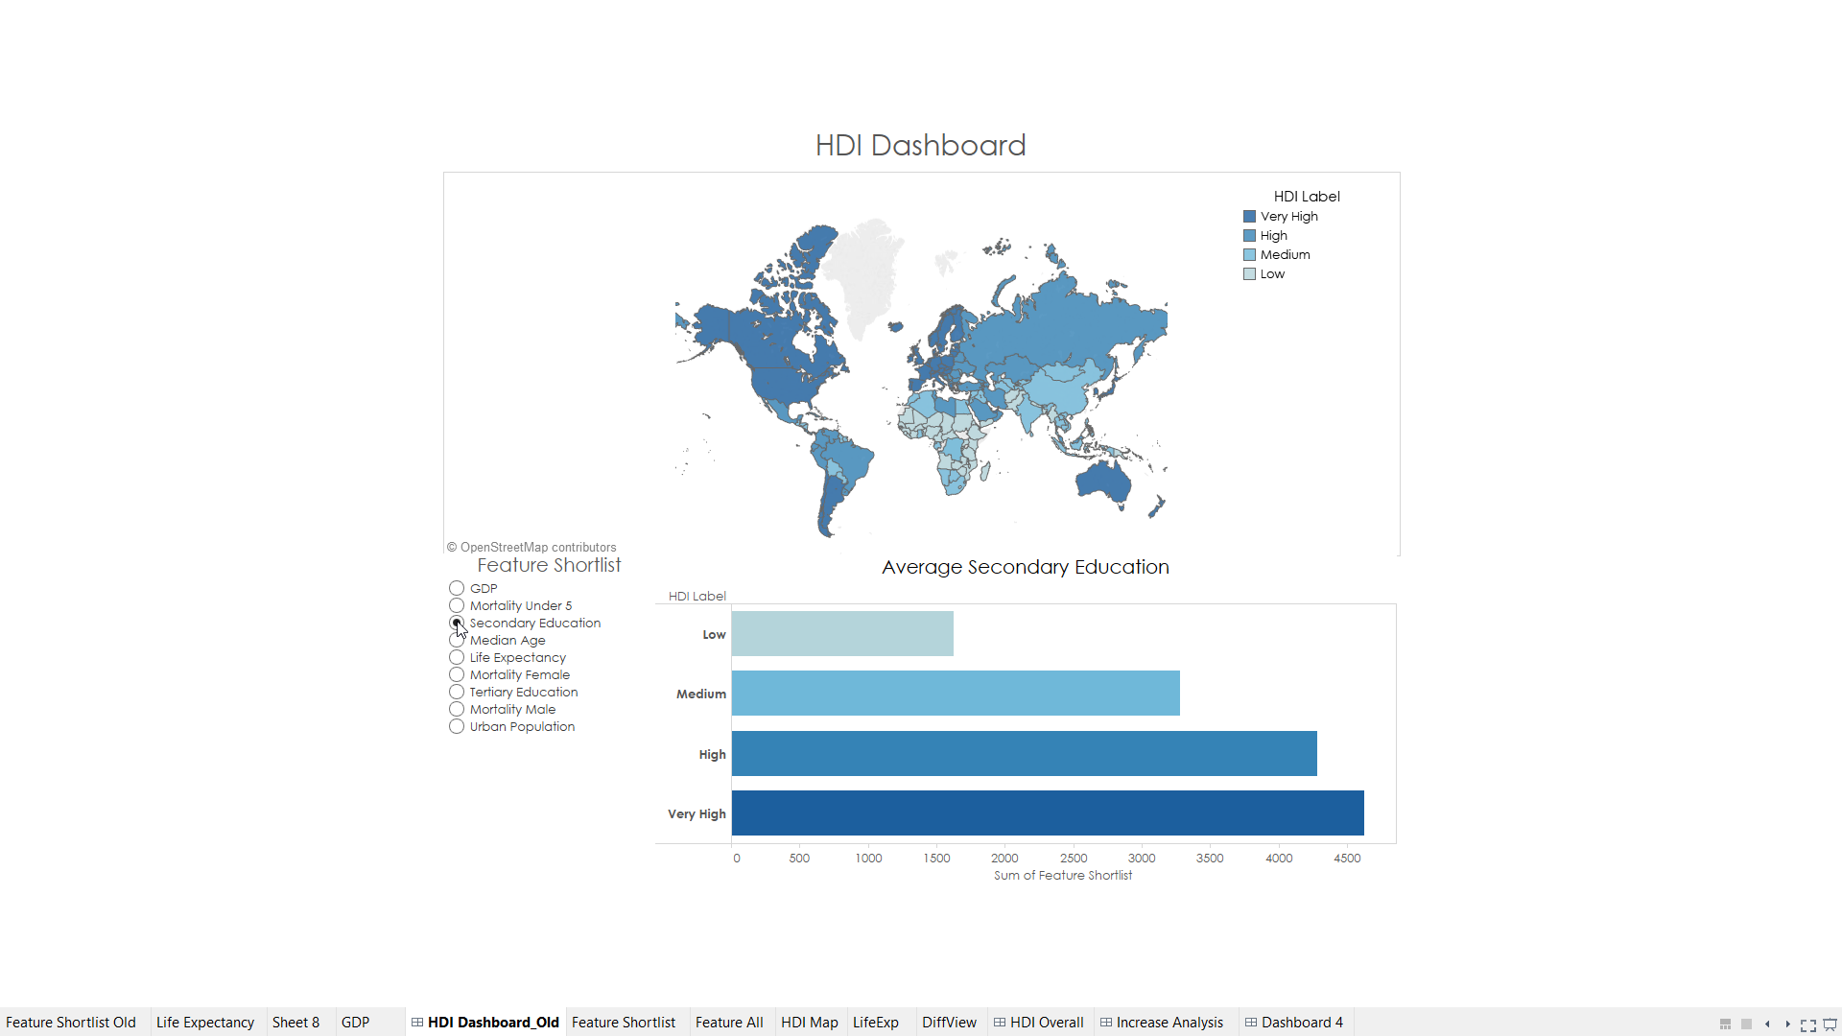

Slide 10
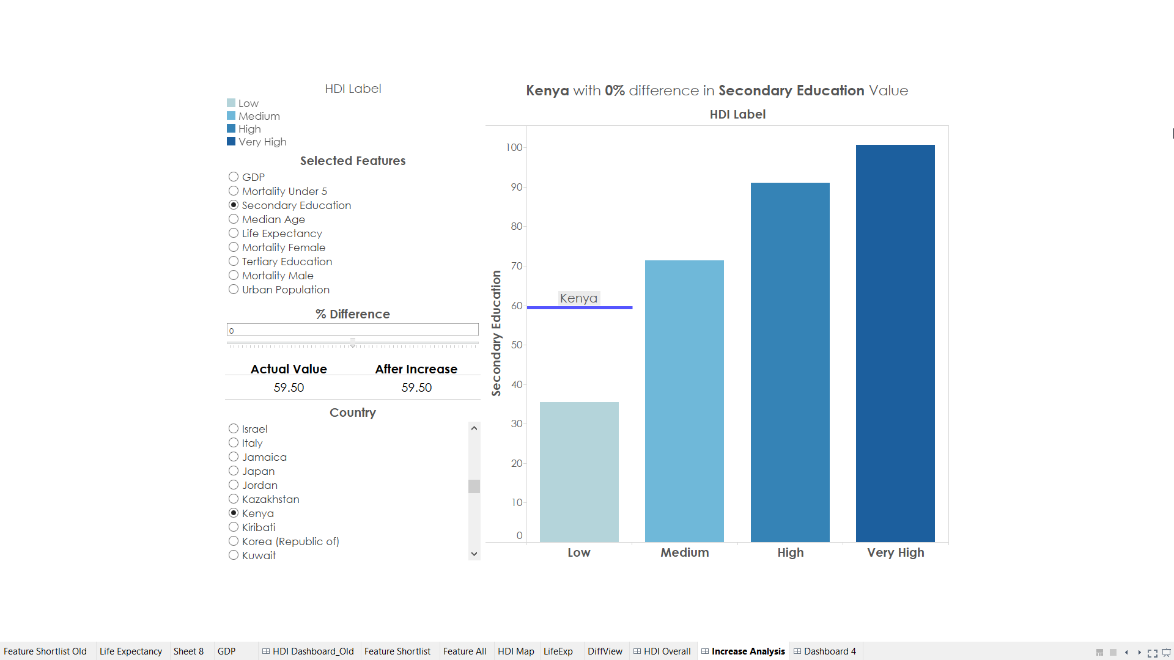

Slide 11
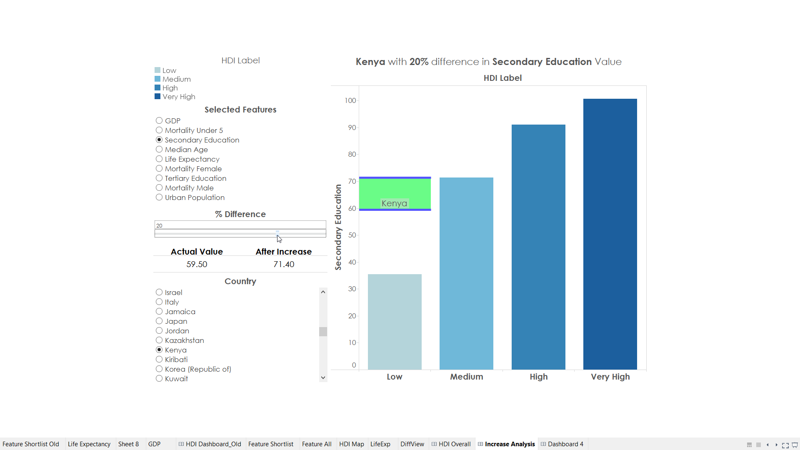

Slide 12
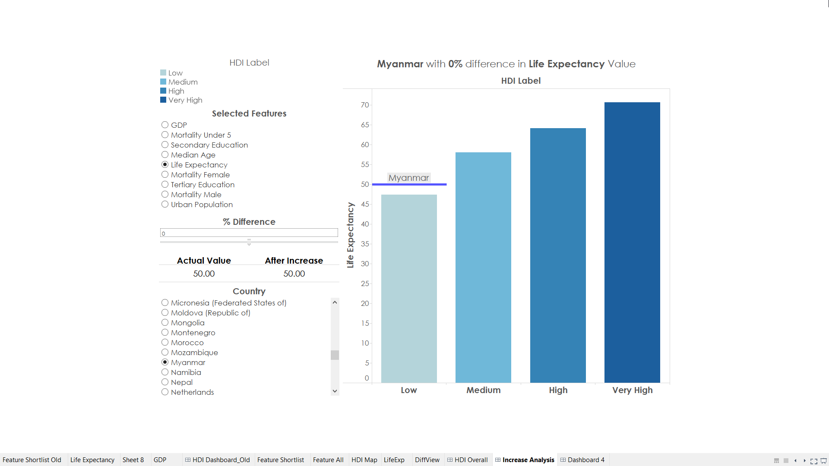

Slide 13
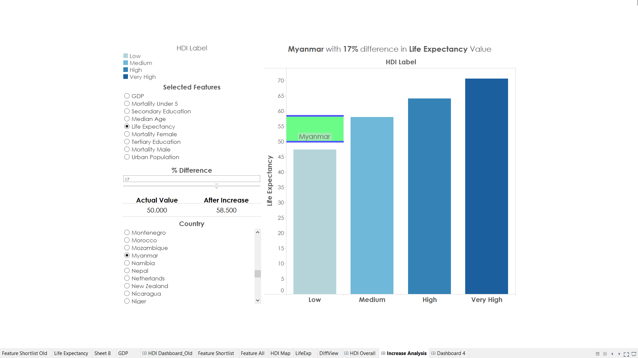

Slide 14
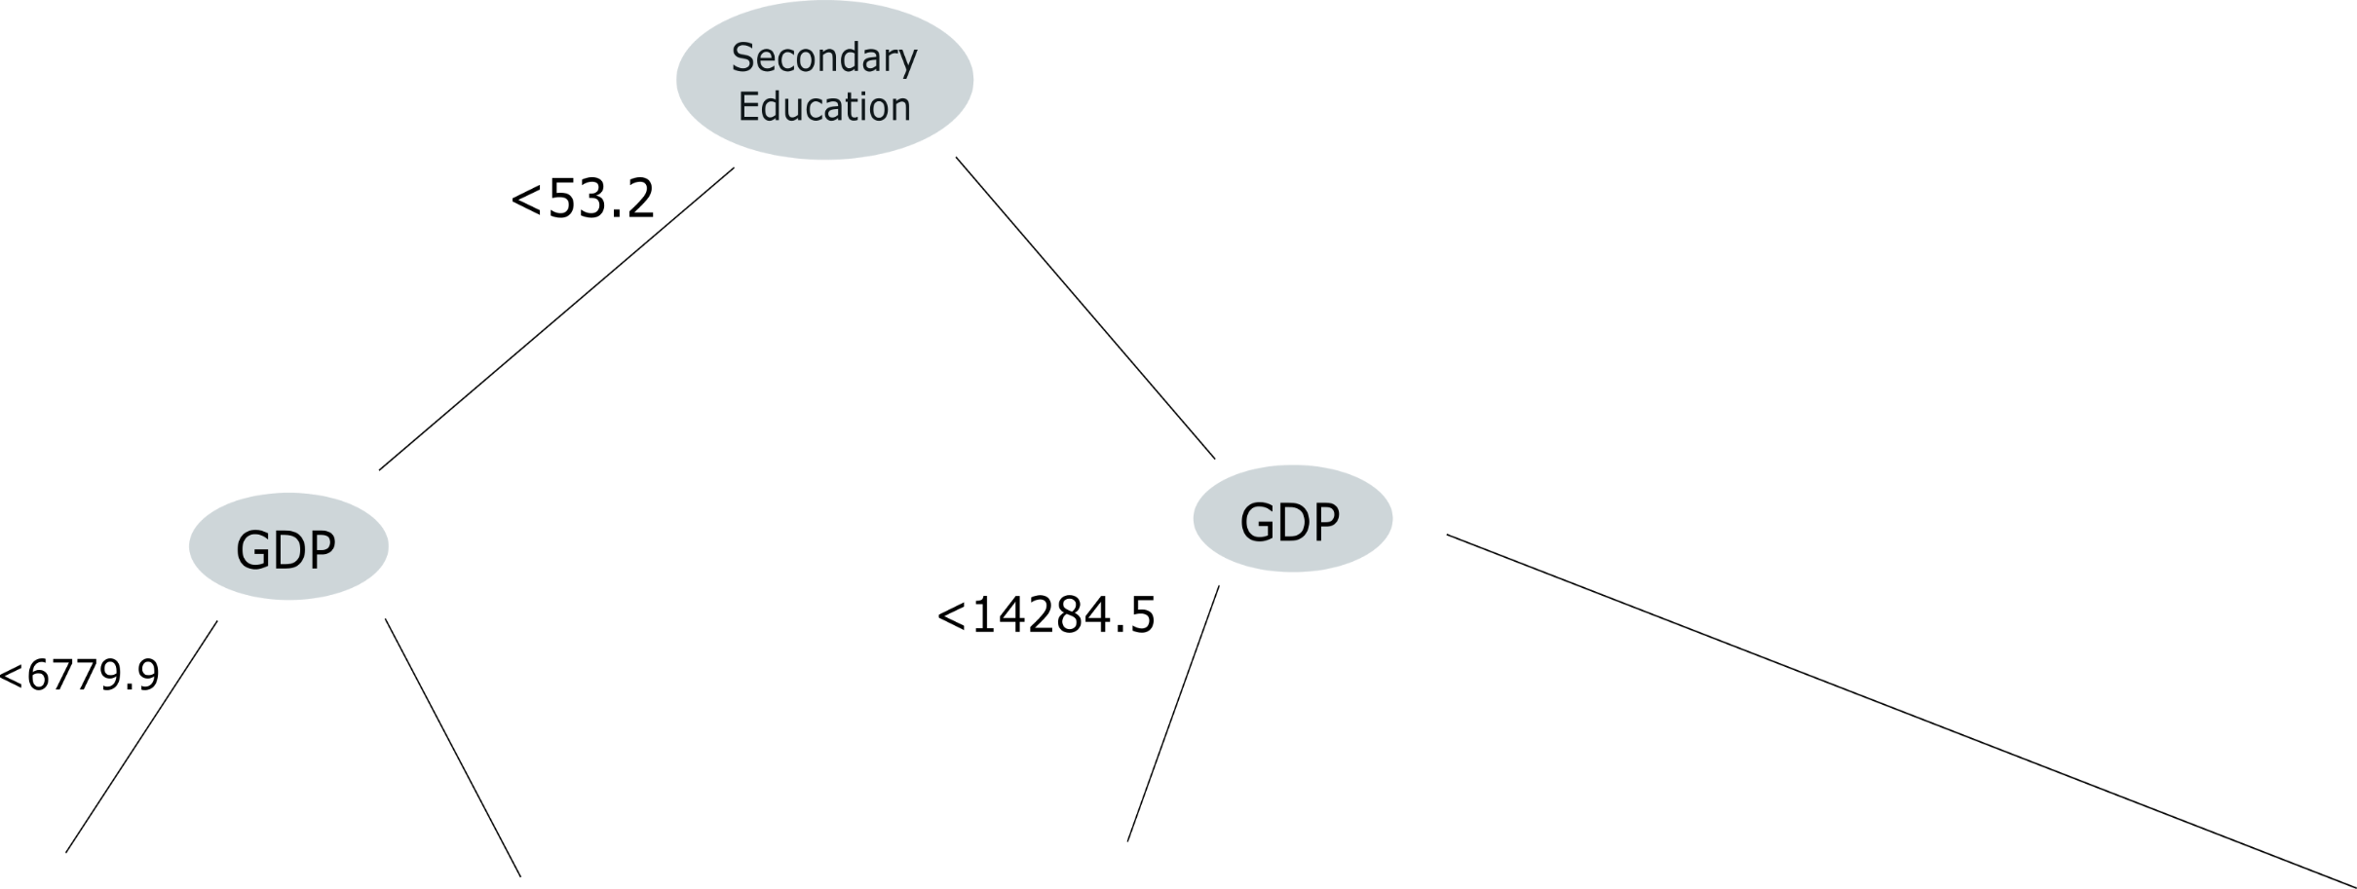
Random Forest model identified Secondary Education & GDP are the key factors in determining HDI

Slide 15
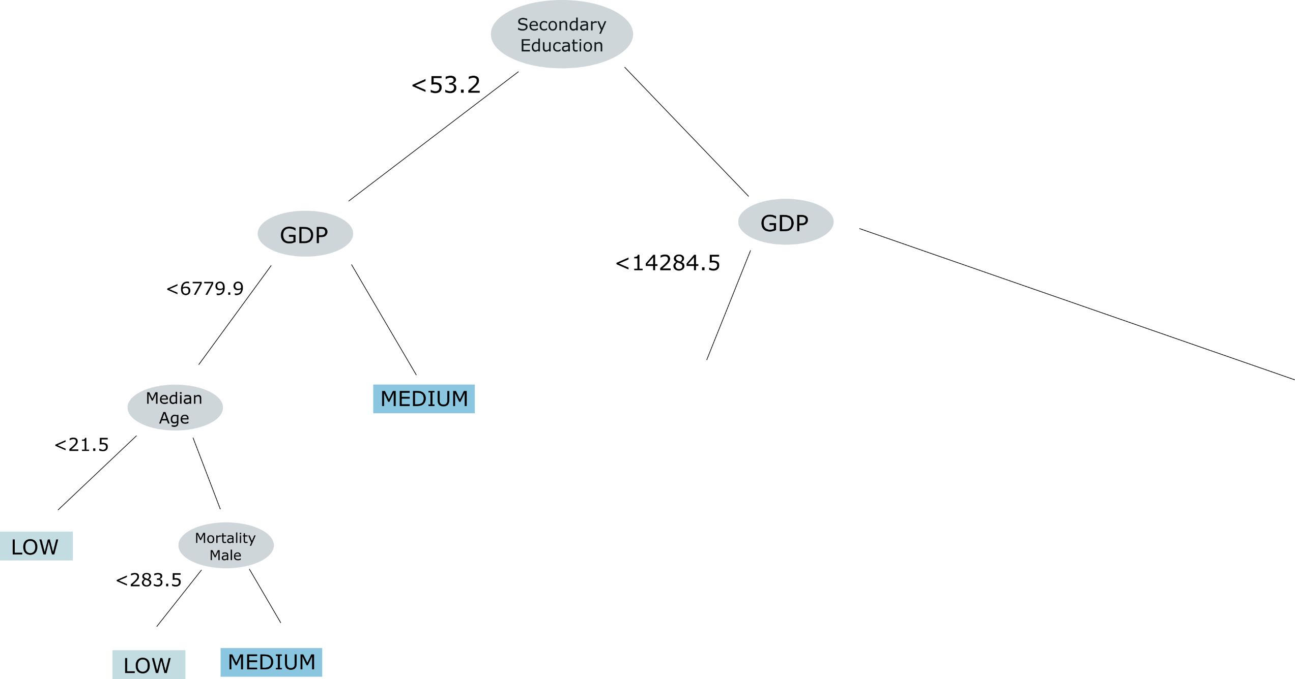
For dividing countries in categories of low and medium, median age and mortality among males were found to be significant

Slide 16
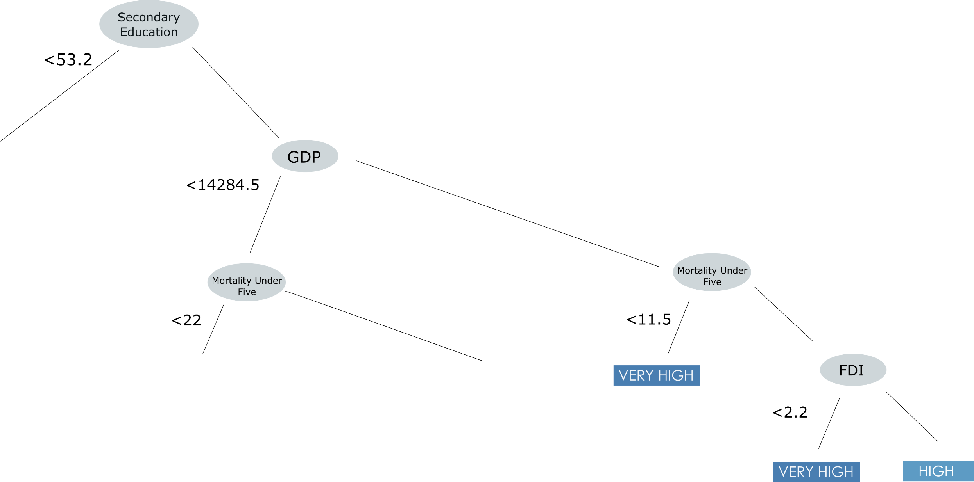
For dividing countries in categories of high and very high, mortality among infants was found to be a significant

Slide 17
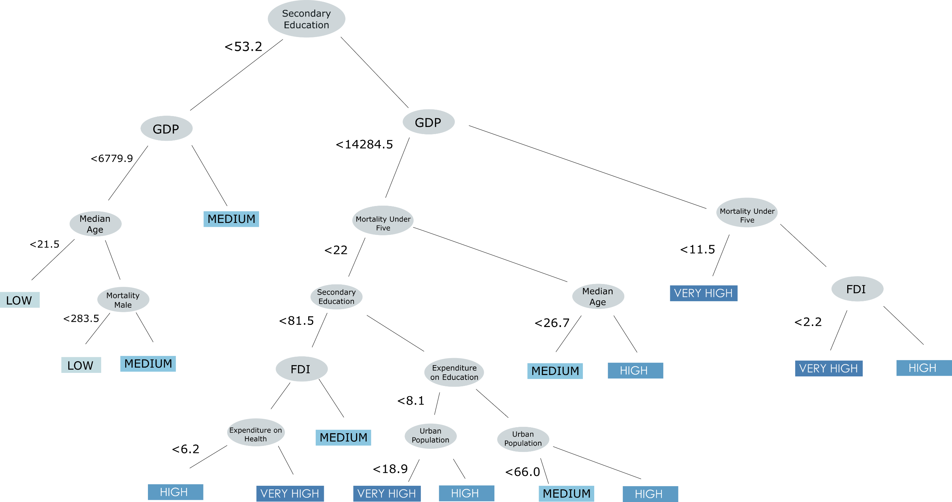
The best decision tree of the random forest model

Slide 18
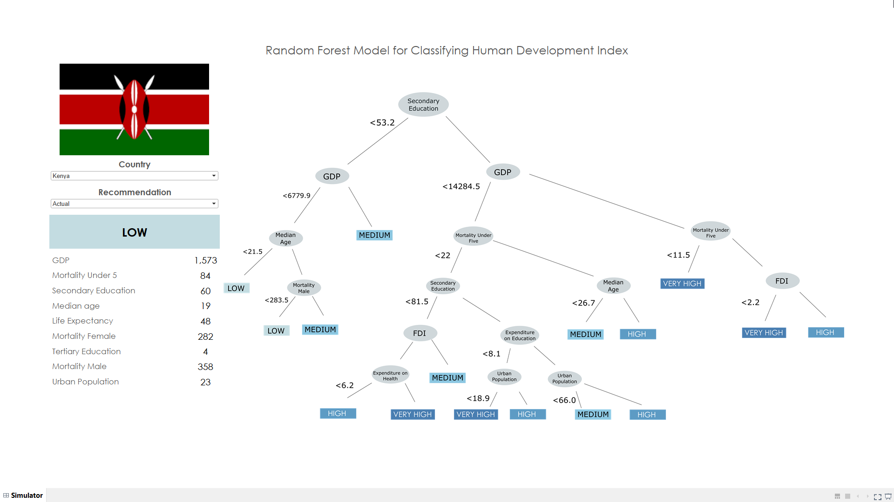

Slide 19


Slide 20
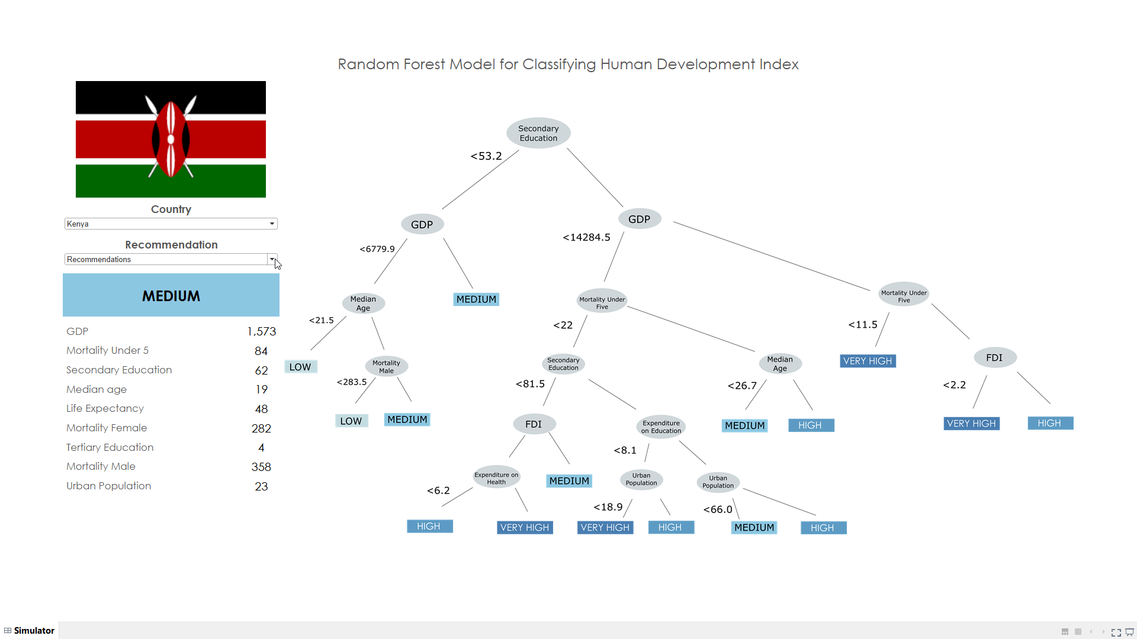

Slide 21
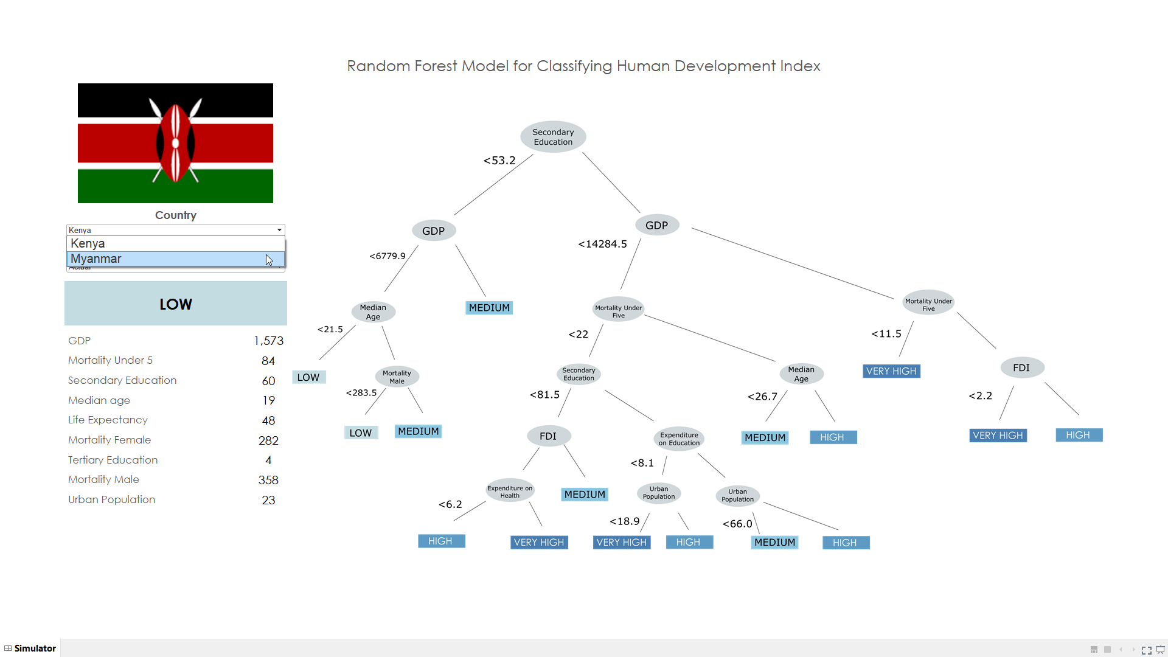

Slide 22
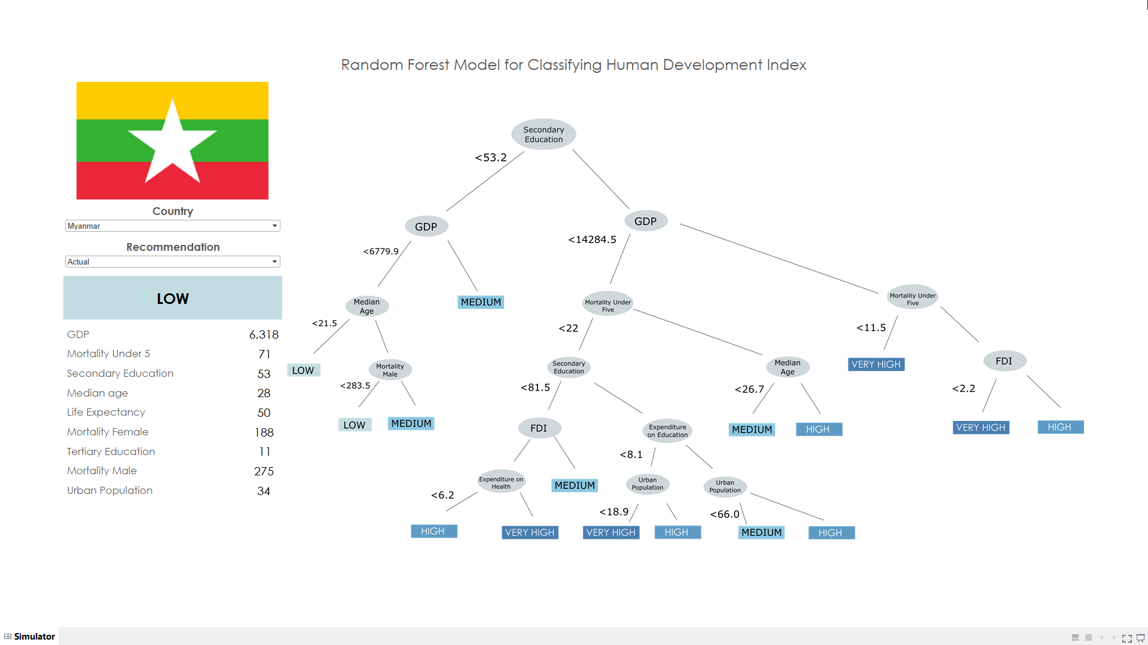

Slide 23
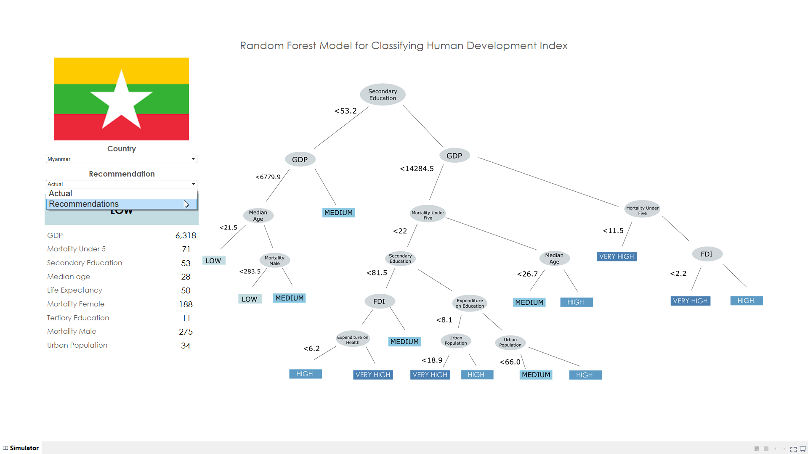

Slide 24
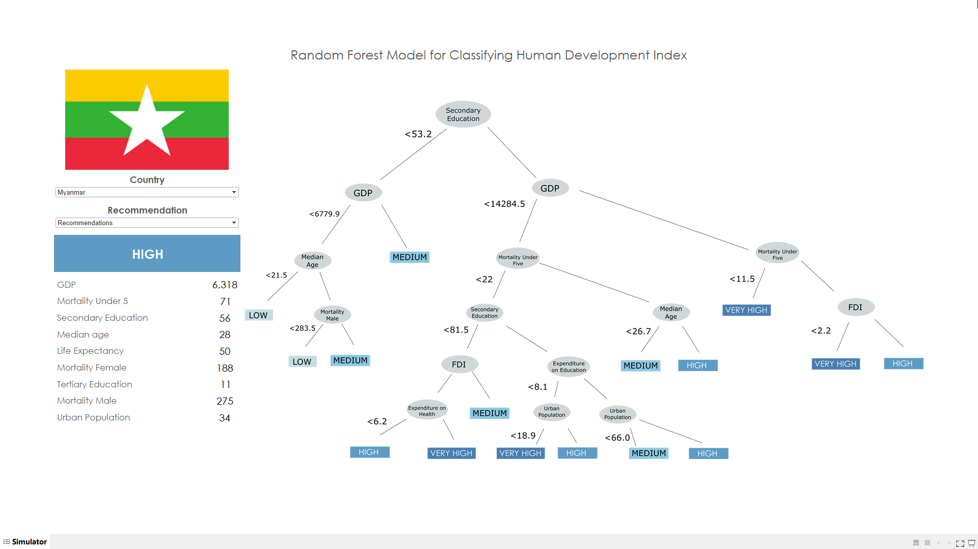

Slide 25
Recommendations to Kenya and Myanmar
Encourage people for education beyond primary school
Invest into schemes for secondary education
Develop more public schools and universities
Subsidize education
Incentivize NGOs to give scholarships and grants for higher education
Provide easy loan facilities for secondary and higher education

Slide 26
For more detailed information about our recommendations, models and simulation please refer to our detailed report on Interpreting Human Develoment Index.

